Slide 1
Software Engineering Sprint 1 Discussion
Group 3
Alessio Pepe - 0622701463
Dario Zito - 0622701512
Paolo Mansi – 062271542
Teresa Tortorella - 0622701507

Slide 2
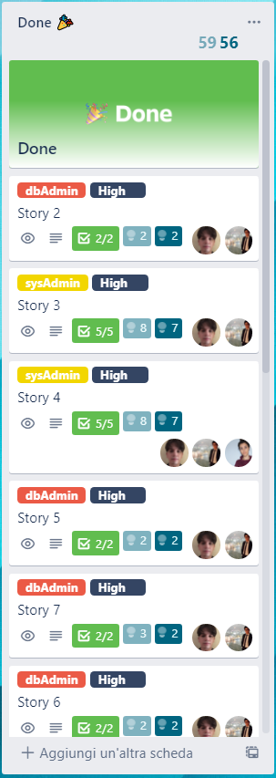
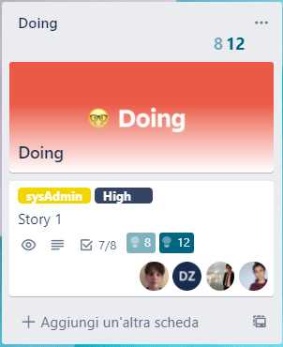
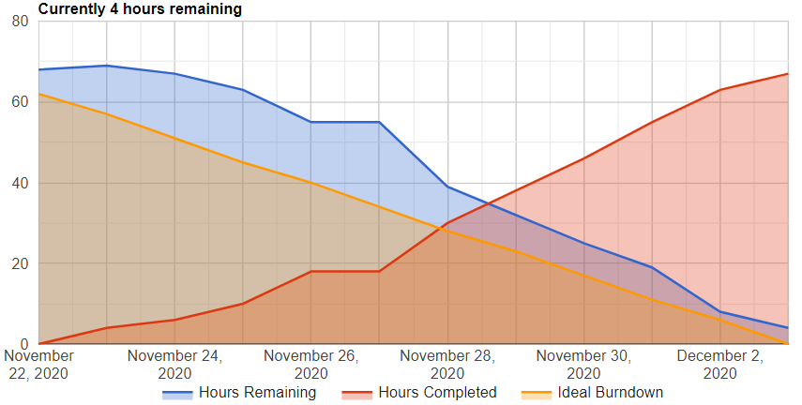
SCRUM

Slide 3
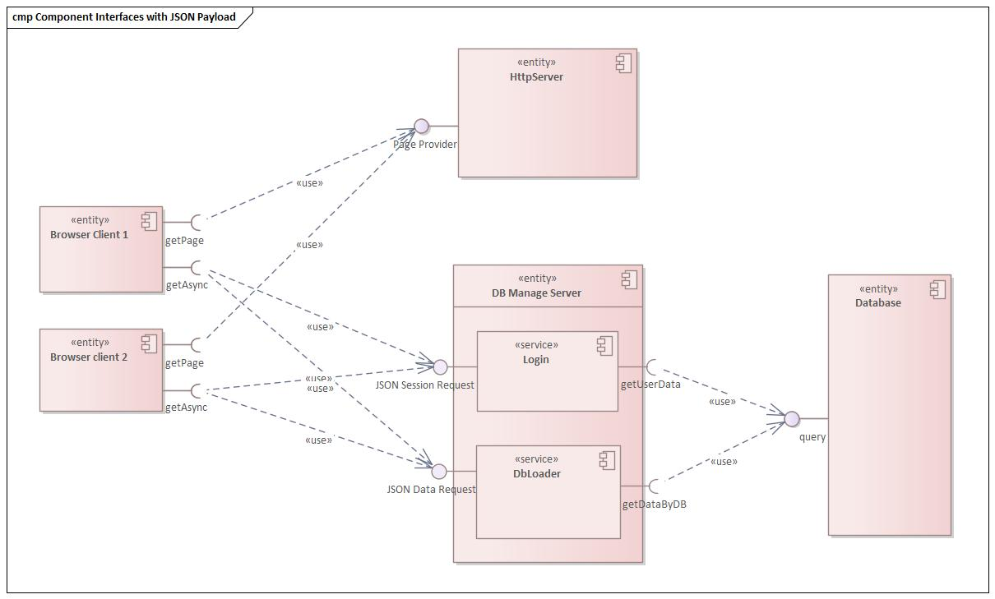
Current High Level Design

Slide 4
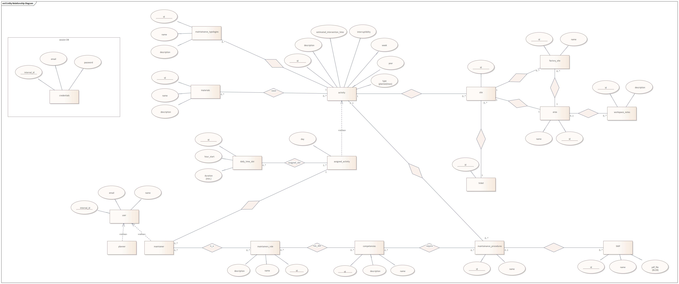
Database E-R Model

Slide 5
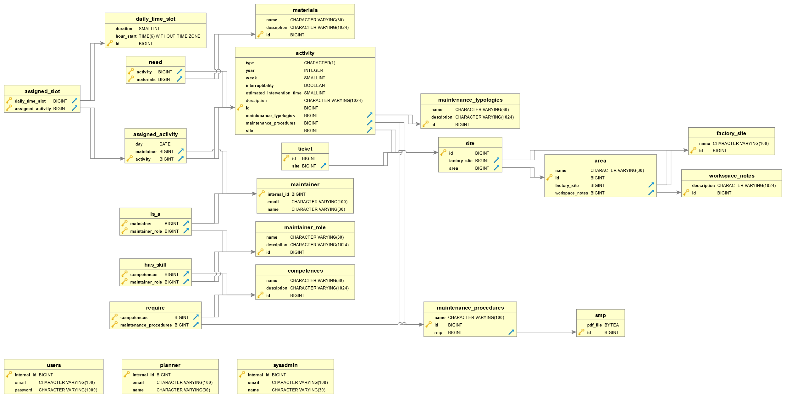
Database Logic Model

Slide 6
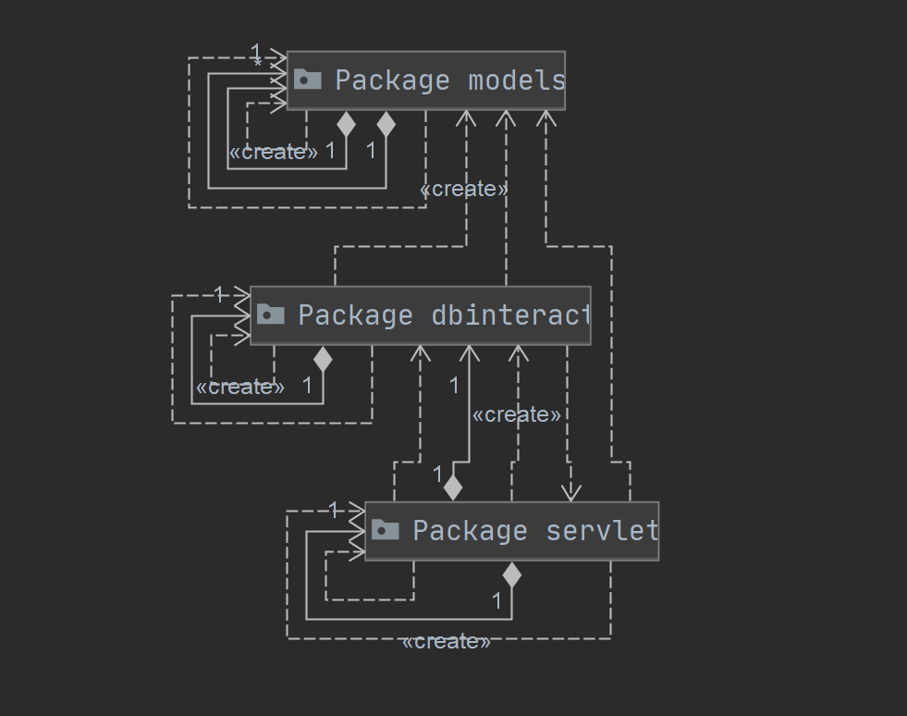
Package Structure

Slide 7
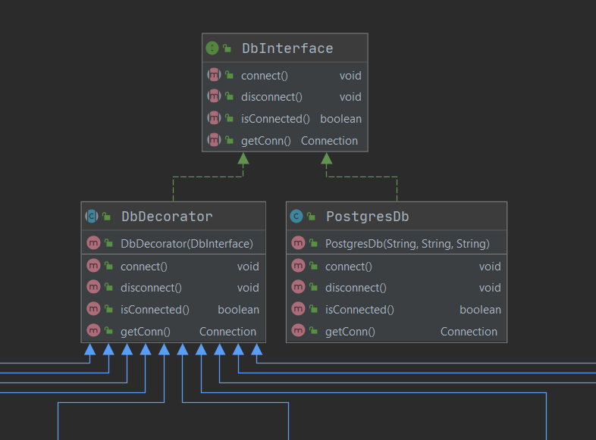
dbinteract Structure
extract

Slide 8
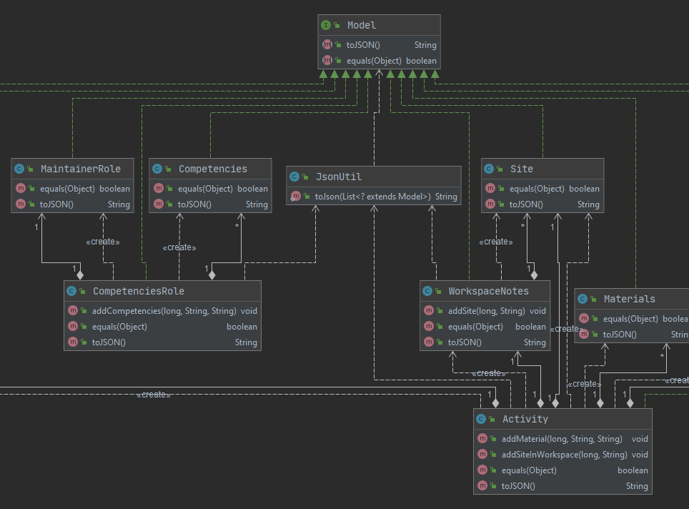
Data Mapping Utils
extract

Slide 9
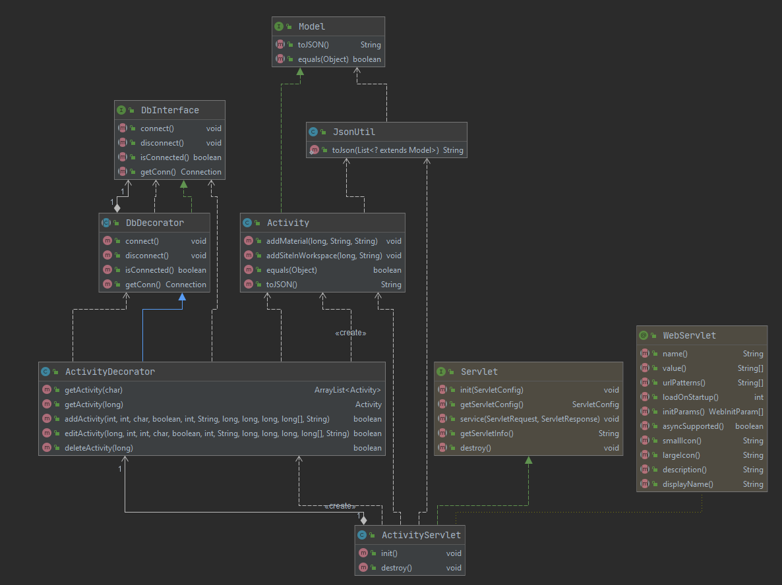
Servlet
Class
extract

Slide 10
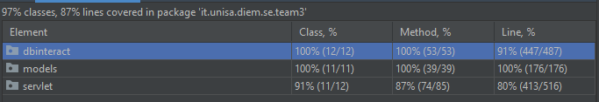
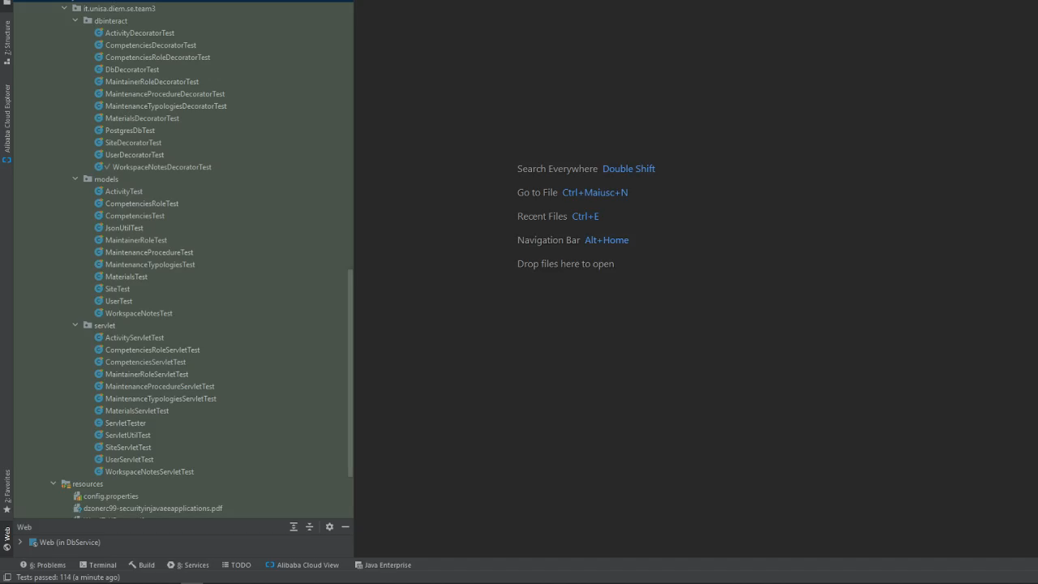
Testing

Slide 11
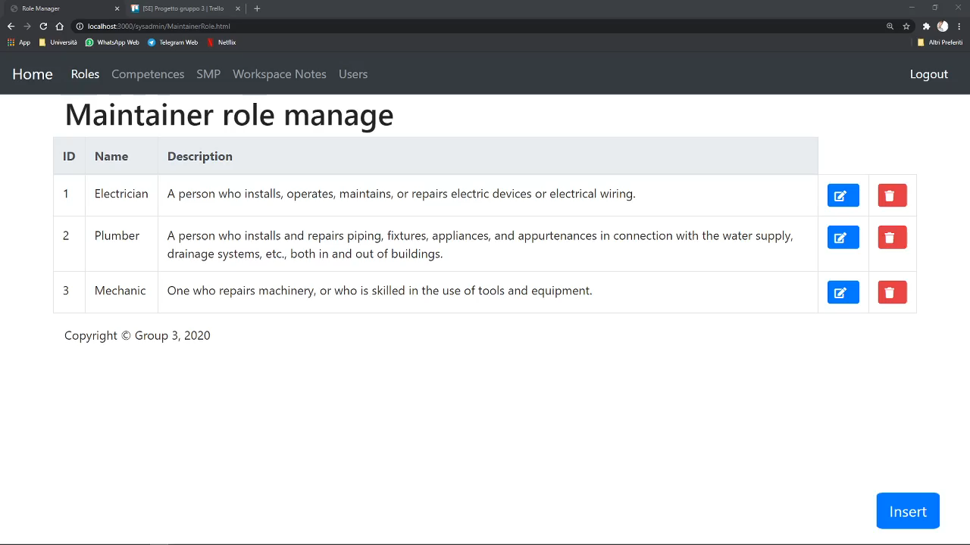
Client Side

Slide 12
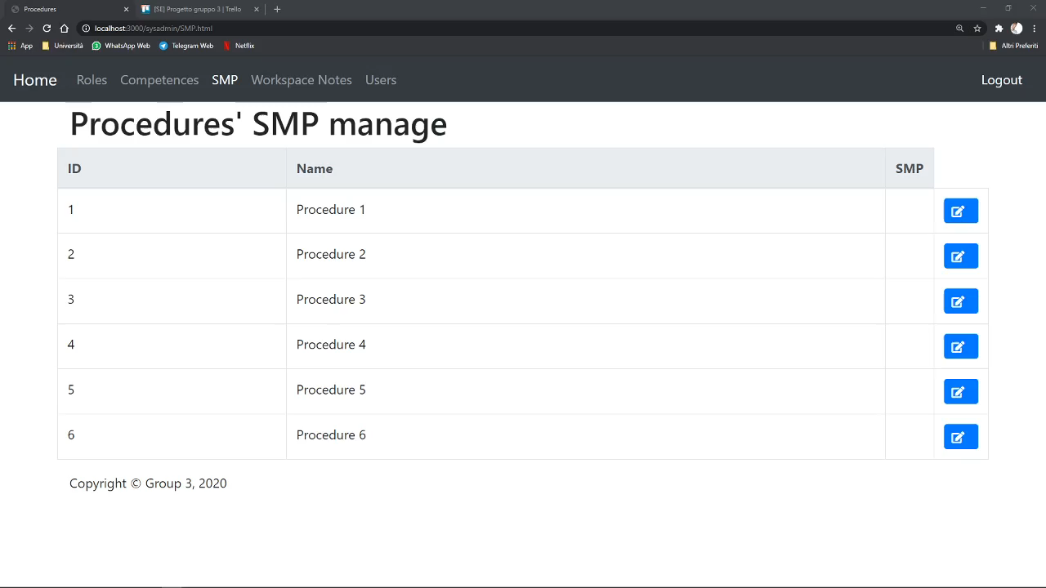
Client Side

